Slide 1
Introduction to Public Speaking

Slide 2
How is Public speaking different from the general one?
Public Speaking
It is defined as the process of talking to group of people in an organized way.
It is deliberate
It is to inform, influence the listeners.
General Speaking
It is defined as a spontaneous way of talking.
It is interactive.
It’s purpose is to engage in a general chitchat (Phatic Communion)

Slide 3
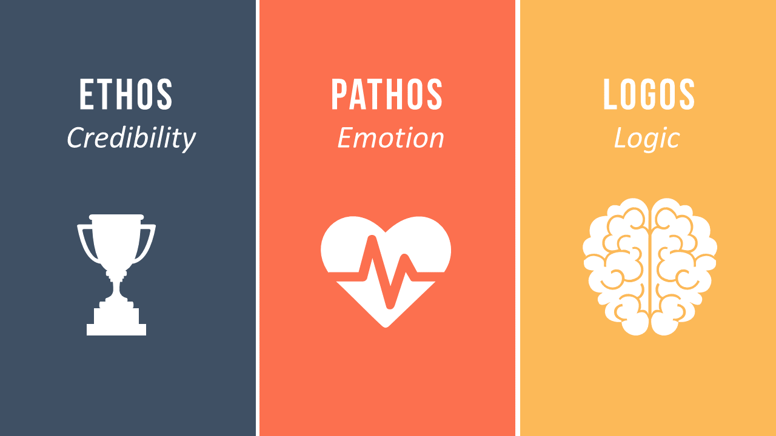
Tools for Public Speaking

Slide 4
It refers to the character of the speaker
It refers to the emotional appeal to the audience
It refers to the words of the speaker

Slide 5
Qualities of a Good Speaker
Has the ability to change the emotions of the people
Has the ability to achieve the purpose of the speech
Knows how to deliver points in an effective manner
Speaks to inspire
Delivers message clearly
Understands human psychology
Understands communication

Slide 6
Two Key Dimensions of Good Public Speaking
Communication (speaking) Skills:
Knowledge of the topic:
Learning story telling techniques learning to humor, learning to maintain audiences’ interest
History
Background
Different aspects/perspective/views of the topic

Slide 7
Tips for Public Speaking
Observation
Studying the art
Practice
Self-Confidence

Slide 8
Forms of Public Speaking
Speech
Presentations
Talk Shows
Live interviews

